Slide 1


SOCIAL
BUZZ

Slide 2


Today's agenda
Project recap
Problem
The Analytics team
Process
Insights
Summary

Slide 3

Social Buzz i a fast growing technology unicorn that need to adapt quickly to it’s global scale.
Accenture has begun a 3 month POC focusing on these tasks:
An audit of Social buzz’s big data practice
Recommendation for a successful IPO
Analysis to find Social Buzz’s top 5 most popular categories of content.
Project Recap

Slide 4


Problem
Over 1000000 posts per day
36,500,000 pieces of content per year!
But how to capitalize on it when there is so much?

Slide 5



Andrew Fleming
Chief Technical Architect
The Analytics team
Marcus Rompton
Senior Principle
Sneha Jha
Data Analyst

Slide 6
Process
1
Data Understanding
2
Data Cleaning
3
Data Modeling
4
Data Analysis
5
Uncover Insights

Slide 7
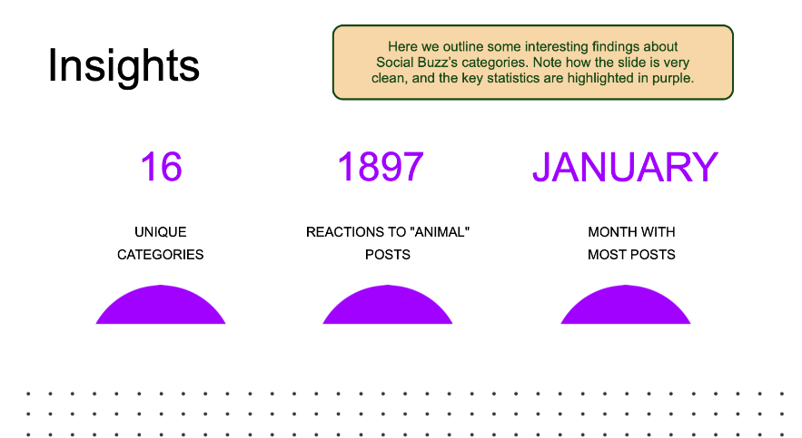

Insights

Slide 8
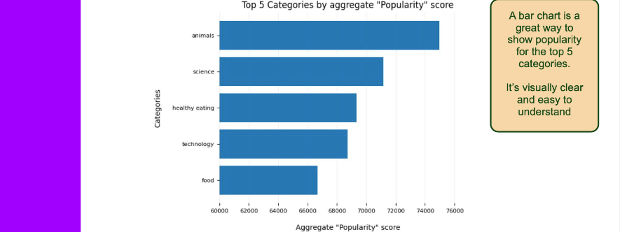

Slide 9
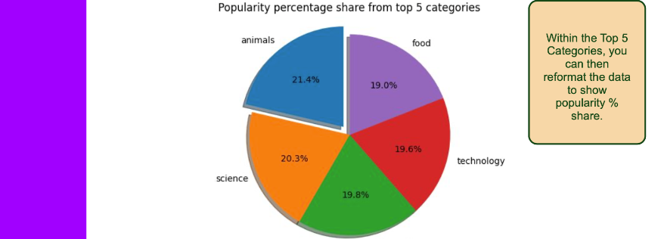

Slide 10
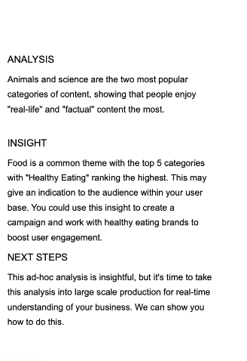

Summary

Slide 11

Thank you!
ANY QUESTIONS?

